Slide 1
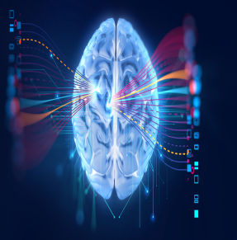
Identifying Pneumonia by Chest X-Ray Images with Deep Learning
Name: Heng Wang, Jiahao Zhao
NU ID: 001822598, 001839375

Slide 2
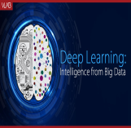

Pneumonia
Description of the topic:
LOGO
Deep Learning
Imagine how efficient it would be to diagnose pneumonia only by analyzing few chest X-Ray images on computers, it would be much more faster and accuracy than viewing by a doctor. It would not only improve the efficiency of identifying pneumonia, but also save more time and effort of professionals.

Slide 3
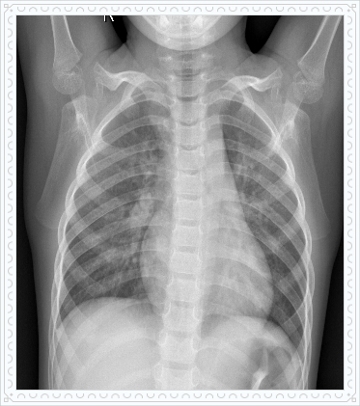
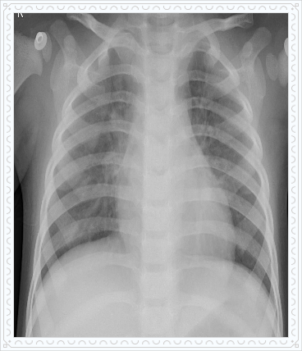
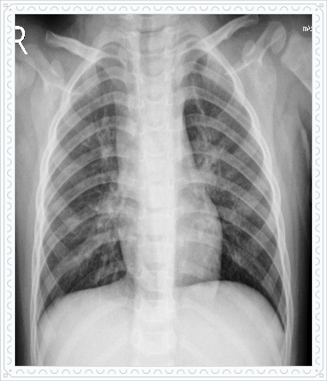
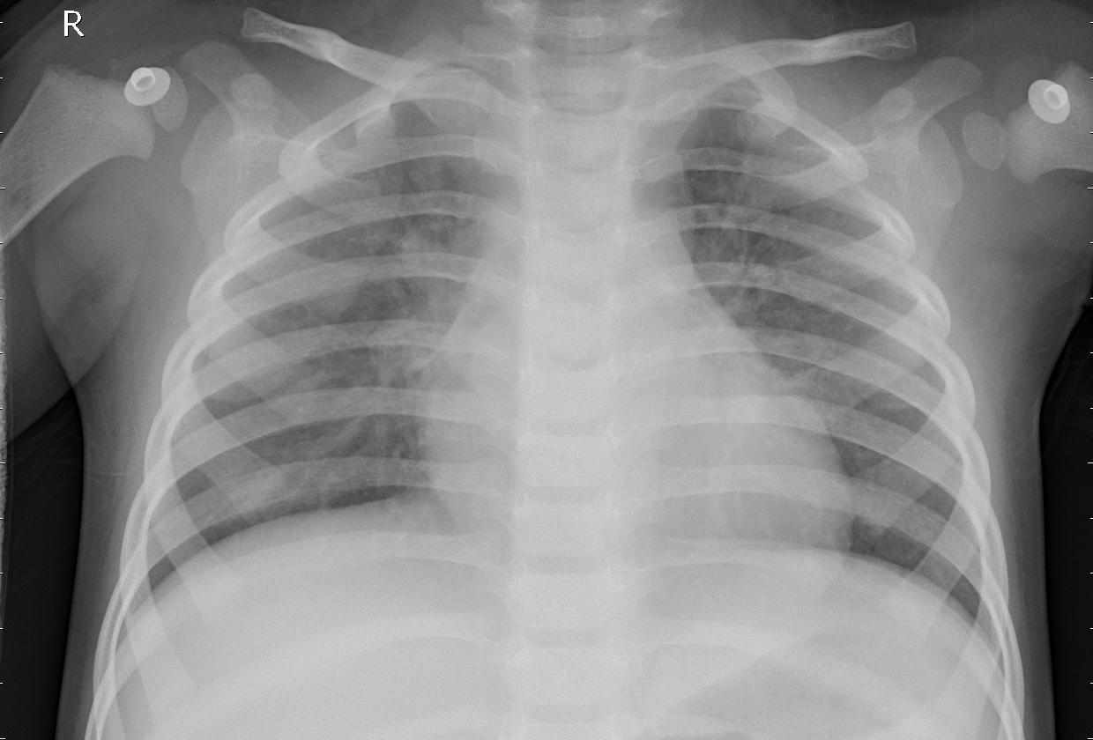
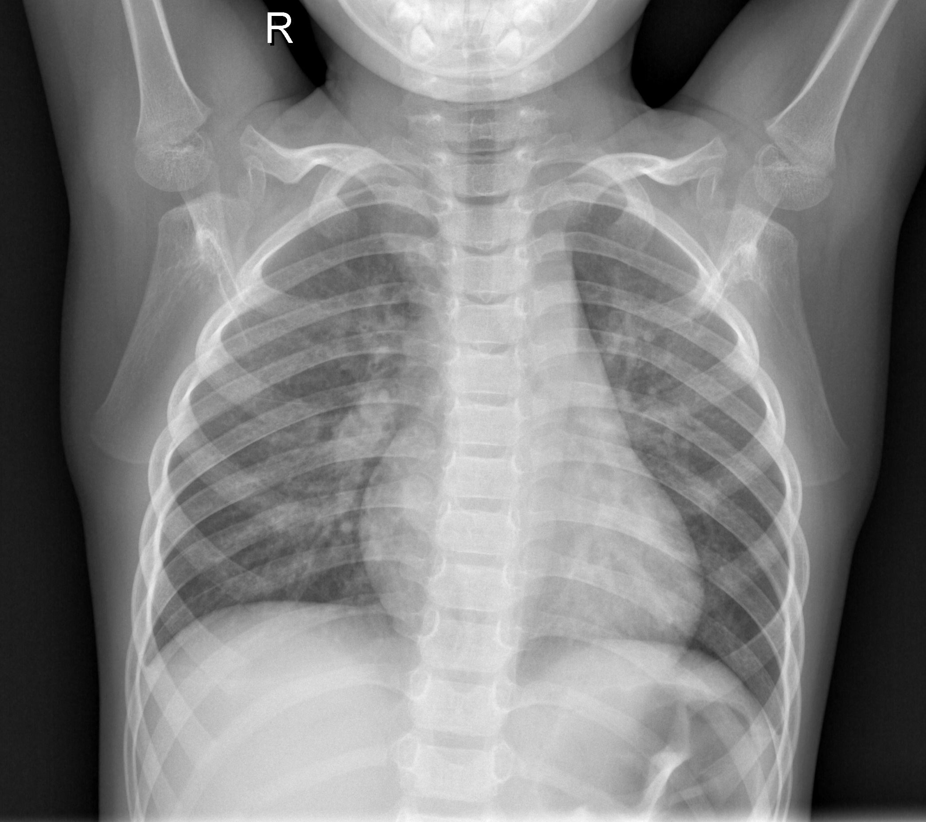
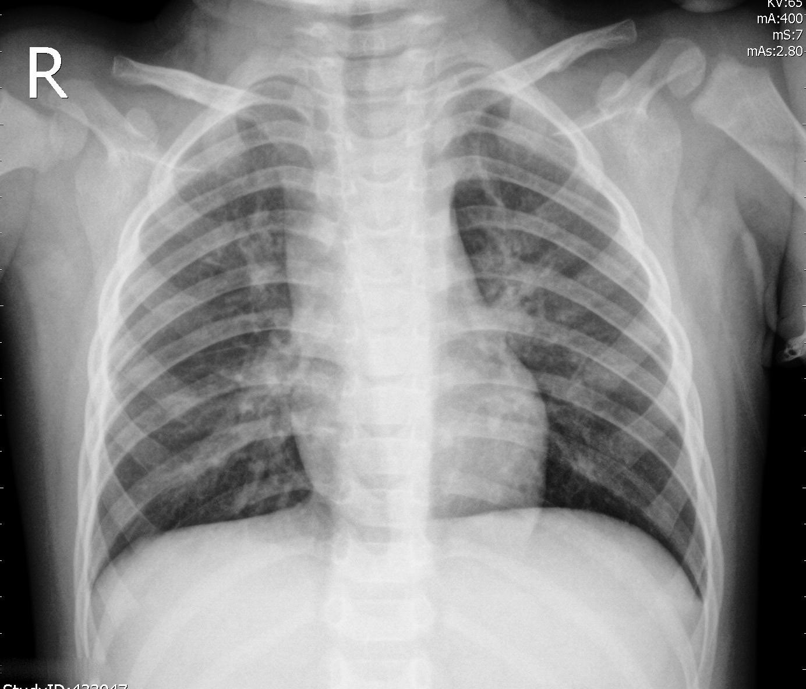
Pneumonia
LOGO
Deep Learning
Normal
Bacterial pneumonia
Viral Pneumonia
The aim of this kernel is to develop a robust deep learning model from scratch on this limited amount of data.

Slide 4
DATASET
LOGO
Deep Learning
The dataset is divided into three sets: 1) train set 2) validation set and 3) test set.
NORMAL
BACTERIA
VIRUS
Each of the above directory contains three sub-directories:
NORMAL: These are the samples that describe the normal (no pneumonia) case.
BAC-PNEUMONIA: This directory contains those samples that are the bacteria pneumonia cases.
VIR-PNEUMONIA : This directory contains those samples that are the virus pneumonia cases.

Slide 5
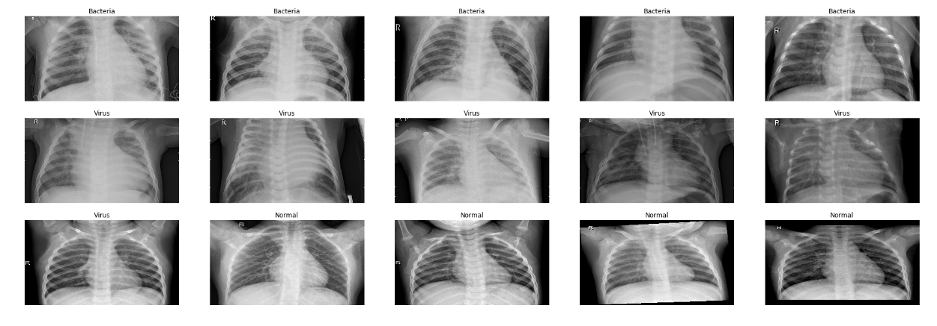
Distinguish
LOGO
Deep Learning
Let's look at how a normal case is different from that of a bacteria and virus pneumonia case. We will look at somes samples from our training data itself.
There are some cases where you won't be able to differentiate between a normal case and a pneumonia case with the naked eye. There is one case in the above plot, at least for me ,which is too much confusing. If we can build a robust classifier, it would be a great assist to the doctor too.

Slide 6
Highlights
LOGO
Deep Learning
PART1. Developed a Depthwise Separable Convolution Neural Network using transfer learning from Imagenet
PART2. Classifying images for normal, bacterial and viral and pneumonia
Highlights
PART3. Augmenting a powerful technique to deal with the imbalanced dataset
PART4. Building deep learning models

Slide 7




MORE THAN TEMPLATE
LOGO
Deep Learning
Virus
28%
Normal
22%
50%
Bacteria
You can see the data is highly imbalanced. We have almost with two bacteria pneumonia cases here as compared to other cases. This situation is very normal when it comes to medical data. The data will always be imbalanced.

Slide 8
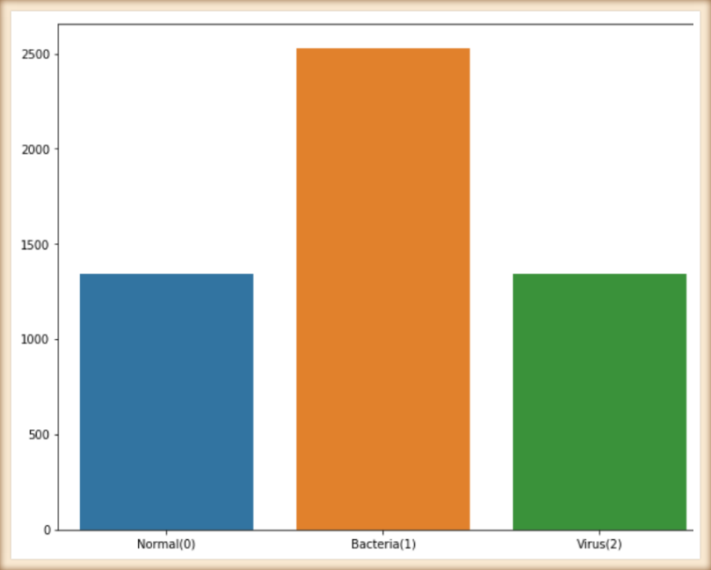
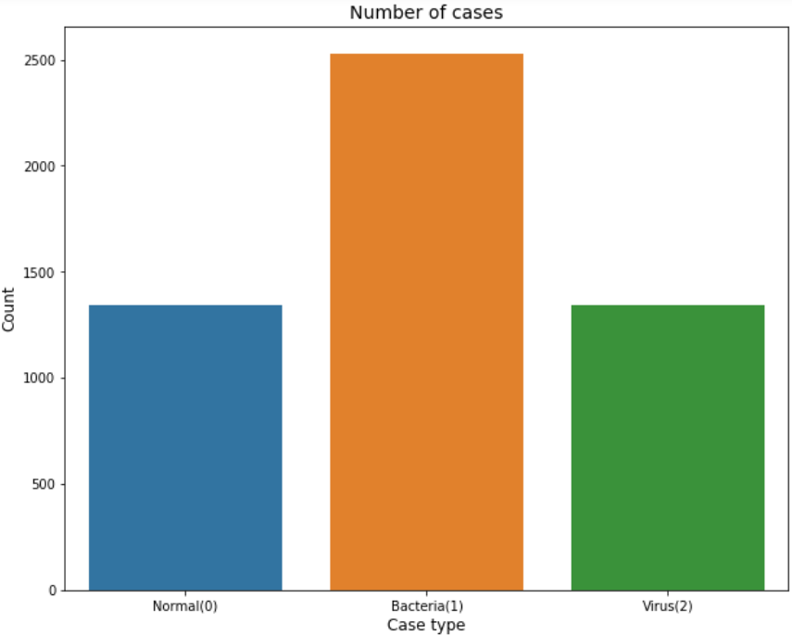
Data Augmentation
LOGO
Deep Learning
Data augmentation is a powerful technique which helps in almost every case for improving the robustness of a model. But augmentation can be much more helpful where the dataset is imbalanced. You can generate different samples of under sampled class in order to try to balance the overall distribution.

Slide 9
Data Augmentation
LOGO
Deep Learning
# Augmentation sequence
seq = iaa.OneOf([
iaa.Fliplr(), # horizontal flips
iaa.Affine(rotate=20), # roatation
iaa.Multiply((1.2, 1.5))]) #random brightness
# generating more samples of the undersampled class
if label==0 and count < batch_size-1:
aug_img1 = seq.augment_image(img)
aug_img1 = cv2.cvtColor(aug_img1, cv2.COLOR_BGR2RGB)
aug_img1 = aug_img1.astype(np.float32)/255.
batch_data[count+1] = aug_img1
batch_labels[count+1] = encoded_label
count +=1
elif label==2 and count < batch_size-1:
aug_img1 = seq.augment_image(img)
aug_img1 = cv2.cvtColor(aug_img1, cv2.COLOR_BGR2RGB)
aug_img1 = aug_img1.astype(np.float32)/255.
batch_data[count+1] = aug_img1
batch_labels[count+1] = encoded_label
count +=1
else:
count+=1
if count==batch_size-1:
break

Slide 10
Building deep learning model
LOGO
Deep Learning
Step 1
Choose a simple architecture.
TEXT
Step 6
Step 2
Start training your network with a lower learning rate along with decay
TEXT
TEXT
Initialize the first few layers from a network that is pretrained on imagenet.
MORE THAN
TEMPLATE
TEXT
Step 3
Step 5
TEXT
Choose layers that introduce a lesser number of parameters.
Add dense layers with reasonable amount of neurons.
TEXT
Step 4
Use batch norm with convolutions.

Slide 11
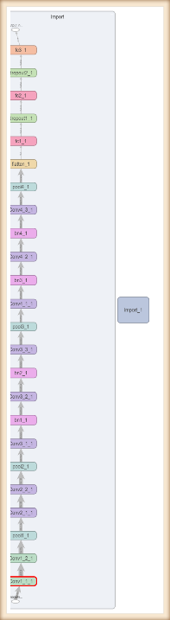
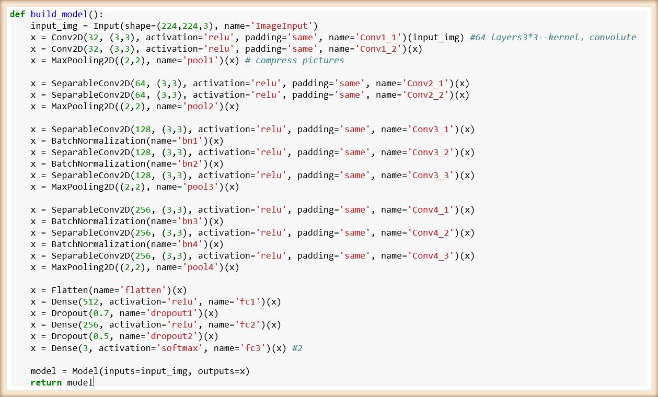
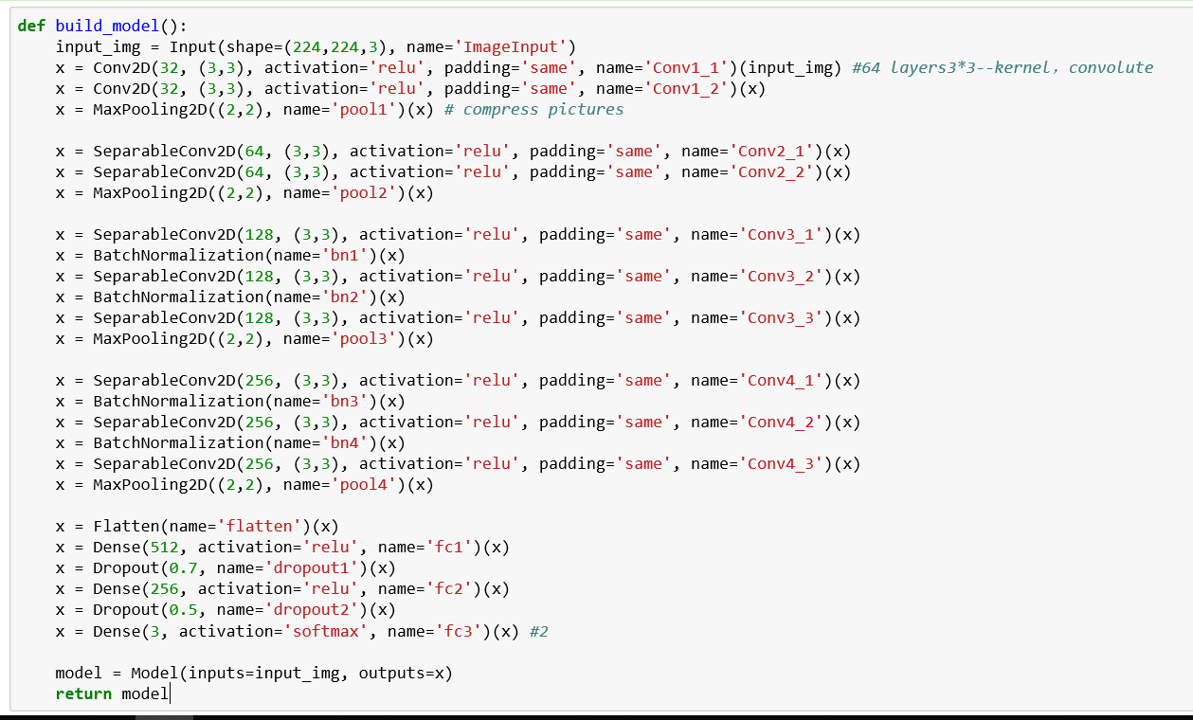
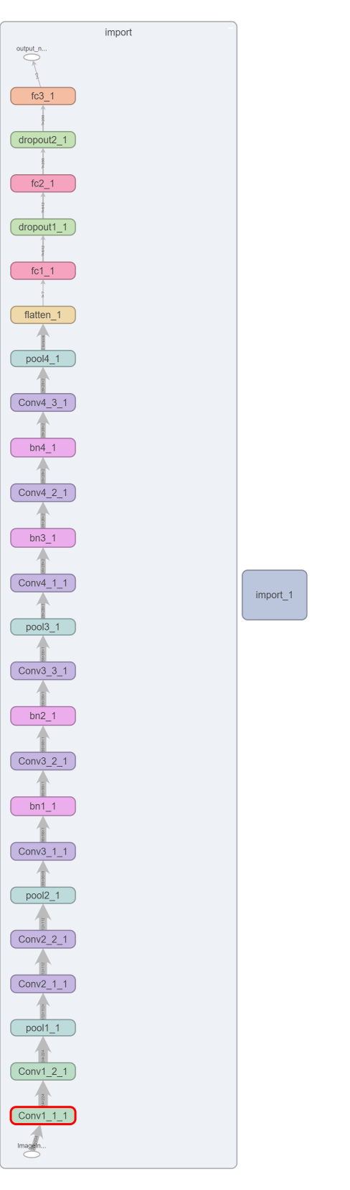
Model
LOGO
Deep Learning

Slide 12
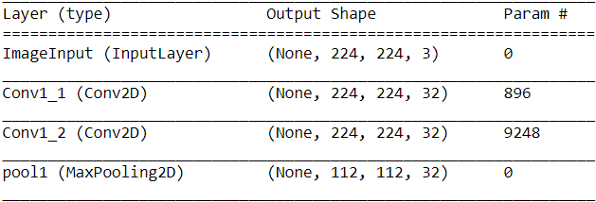
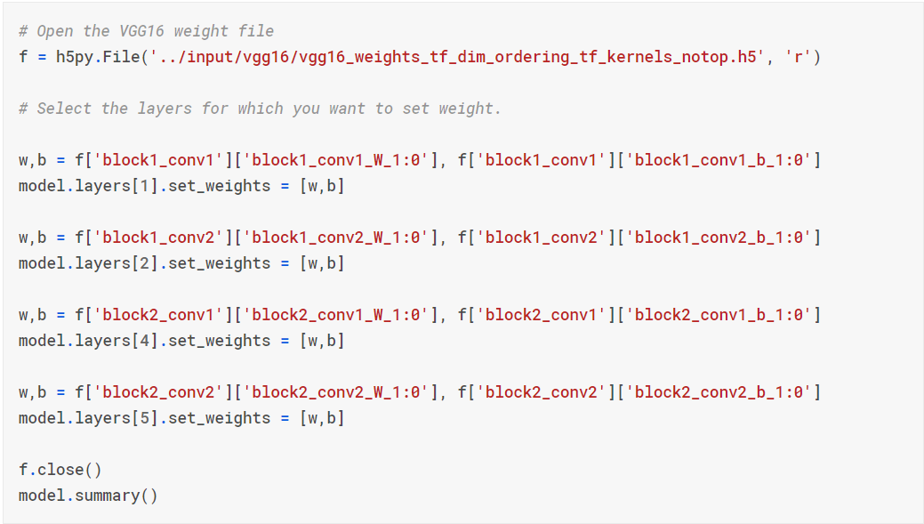
Model details
LOGO
Deep Learning
Step 2
TEXT
Initialize the first few layers from a network that is pretrained on imagenet.
This is because first few layers capture general details like color blobs, patches, edges, etc. Instead of randomly initialized weights for these layers, it would be much better if you fine tune them.
We will initialize the weights of first two convolutions with VGG16 weights.

Slide 13
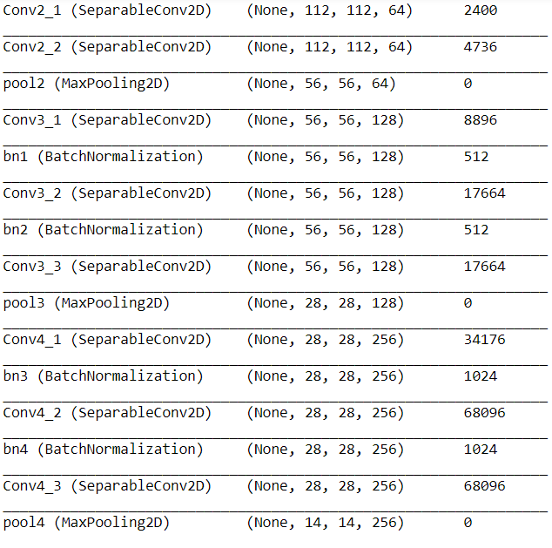
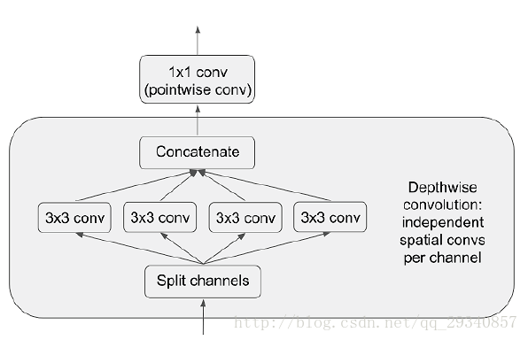
Model details
LOGO
Deep Learning
TEXT
Step 3
Choose layers that introduce a lesser number of parameters.
For example, Depthwise Separable Convolution is a good replacement for Convolution layer. It introduces lesser number of parameters as compared to normal convolution and as different filters are applied to each channel, it captures more information.
Compare to Conv2D: 3*3*64*64
SeparableConv2D: 3*3*64*64

Slide 14
Model details
LOGO
Deep Learning
TEXT
Step 4
Use batch norm with convolutions.
We normalize the input layer by adjusting and scaling the activations. For example, when we have features from 0 to 1 and some from 1 to 1000, we should normalize them to speed up learning. If the input layer is benefiting from it, why not do the same thing also for the values in the hidden layers, that are changing all the time, and get 10 times or more improvement in the training speed.

Slide 15
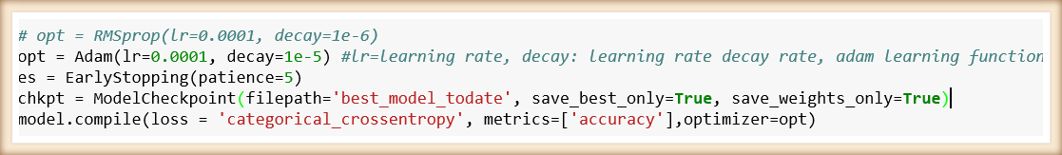
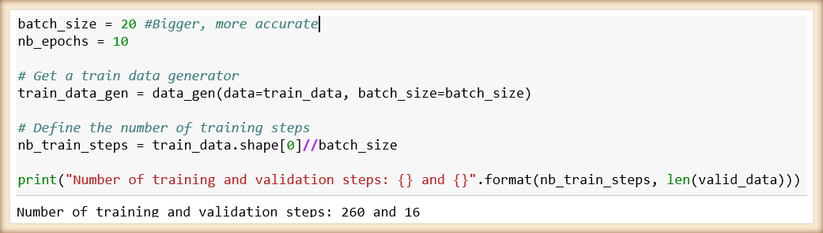
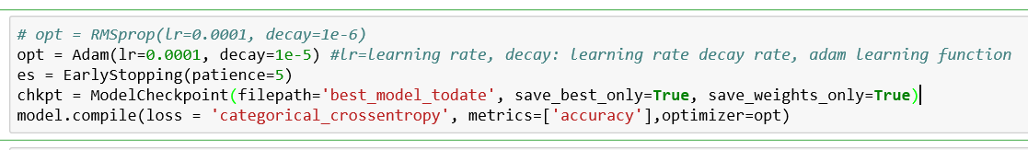
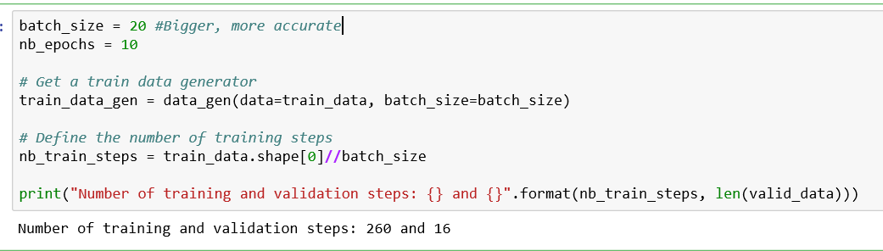
Model Detail
LOGO
Deep Learning

Slide 16
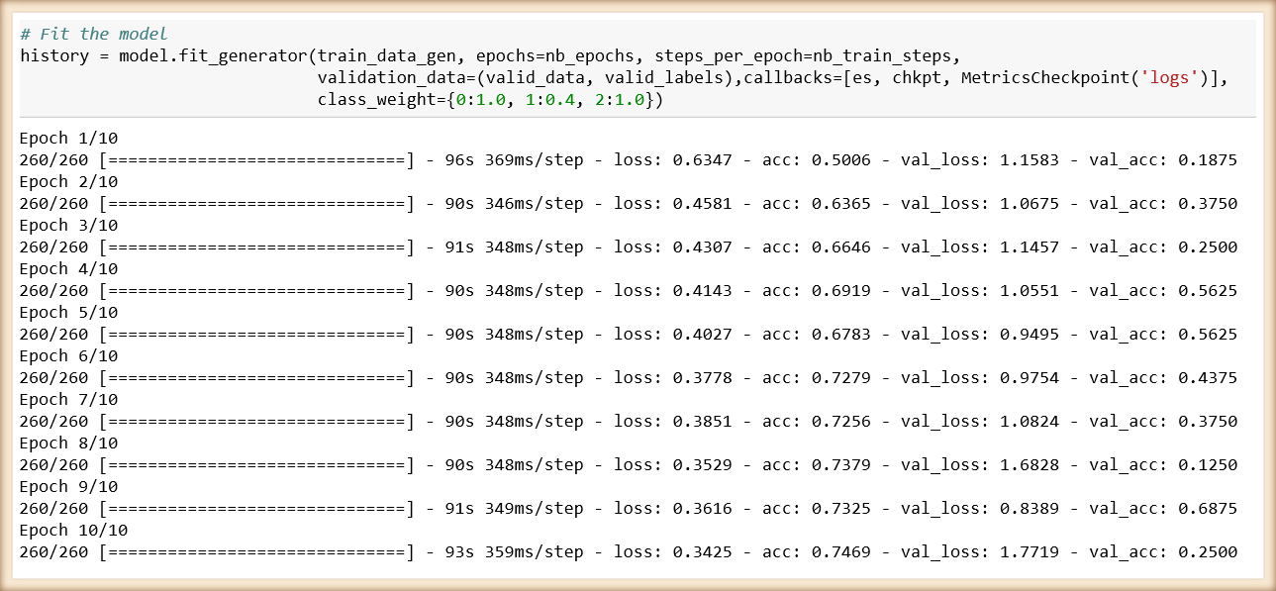
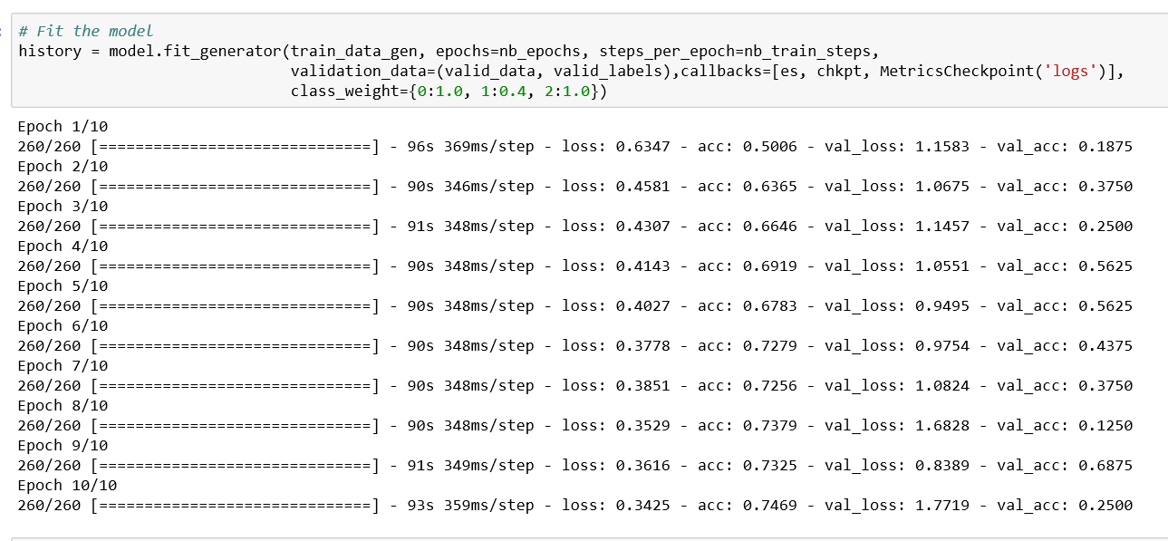
Fit the model
LOGO
Deep Learning

Slide 17
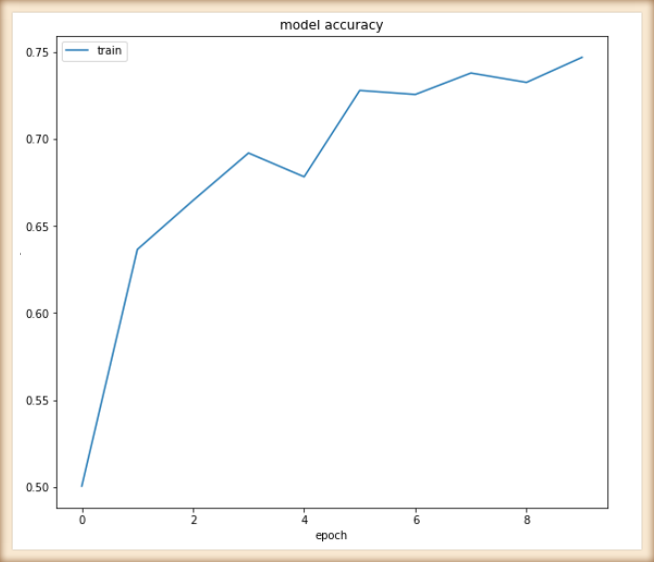
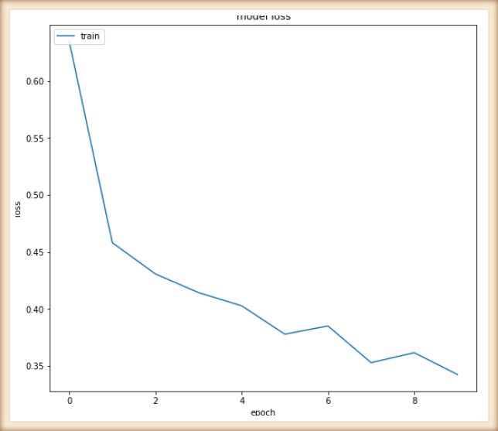
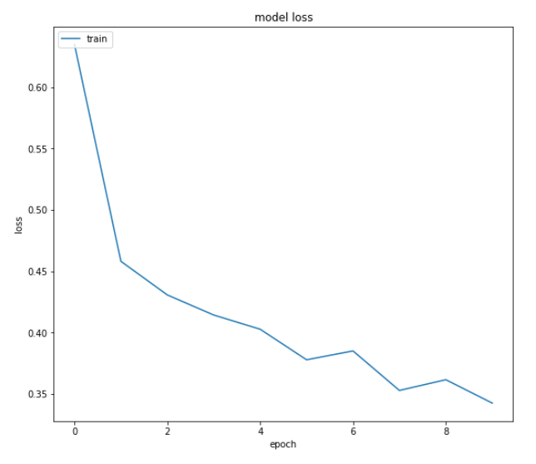
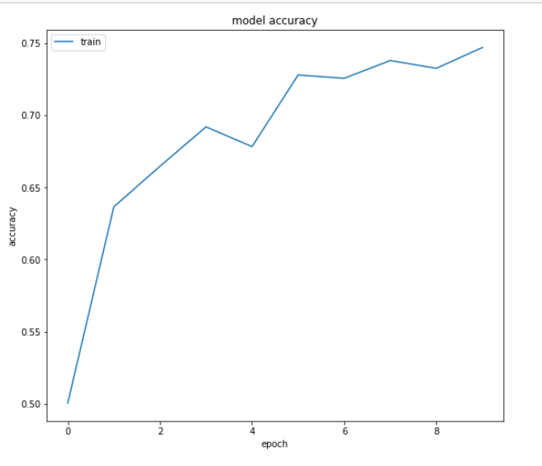
MORE THAN TEMPLATE
LOGO
Deep Learning
Evaluate Convolutional Network

Slide 18
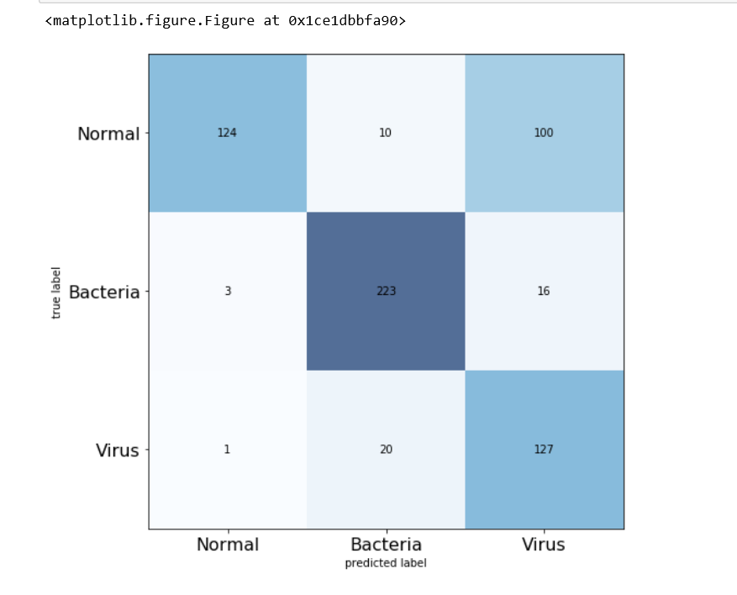
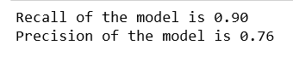
Result
LOGO
Deep Learning
When a particular problem includes an imbalanced dataset, then accuracy isn't a good metric to look for. For example, if your dataset contains 95 negatives and 5 positives, having a model with 95% accuracy doesn't make sense at all. The classifier might label every example as negative and still achieve 95% accuracy. Hence, we need to look for alternative metrics. Precision and Recall are really good metrics for such kind of problems.

Slide 19
Thanks for viewing

